Slide 1
Reinforcement Learning for Control with Multiple Frequencies
Literature review

Slide 2
Contents
1
Motivation
2
Methodology
3
Empirical study

Slide 3
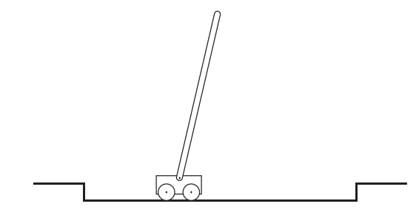
1 Motivation
Traditional discrete-time Markov decision processes
Assume all decision variables are simultaneously determined at every time step
Implement action every step
Car to left
Car to right
Pole fall to left
Pole stay still
Pole fall to right
Observe the environment every step
Notes:
Markov decision processes are intended to include just these three aspects—sensation, action, and goal—in their simplest possible forms without trivializing any of them.

Slide 4


1 Motivation
Traditional discrete-time Markov decision processes
Assume all decision variables are simultaneously determined at every time step
Implement action every step
Car to left
Car to right
Pole fall to left
Pole stay still
Pole fall to right
Observe the environment every step
$a^{1}$Move every 2 time step
$a^{2}$Move every 3 time step
Notes:
Markov decision processes are intended to include just these three aspects—sensation, action, and goal—in their simplest possible forms without trivializing any of them.

Slide 5
1 Motivation
Traditional discrete-time Markov decision processes
Assume all decision variables are simultaneously determined at every time step
Implement action every step
Car to left
Car to right
Pole fall to left
Pole stay still
Pole fall to right
Observe the environment every step
Non-stationary nature of optimal policy
$a^{1}$Move every 2 time step
$a^{2}$Move every 3 time step
Notes:
Markov decision processes are intended to include just these three aspects—sensation, action, and goal—in their simplest possible forms without trivializing any of them.

Slide 6


1 Motivation
Discrete time factored action MDP
$a^{1}$Move every 2 time step
Multiple action persistence
$a^{2}$Move every 3 time step

Slide 7
1 Motivation
Discrete time factored action MDP
$a^{1}$Move every 2 time step
Multiple action persistence
$a^{2}$Move every 3 time step
How to optimize a periodic non-stationary policy while circumventing the exponential growth of time complexity with respect to the periodicity of action persistence.

Slide 8
1 Motivation
Discrete time factored action MDP
Move every 2 time step
Multiple action persistence
Move every 3 time step
How to optimize a periodic non-stationary policy while circumventing the exponential growth of time complexity with respect to the periodicity of action persistence.

Slide 9



2 Methodology
Discrete time factored action MDP (FA-MDP)
Action in vector representation
State transition
Policy over action mapped from history
$$a=(a^{1},…,a^{m})$$
$$P\left(s′ | s,a\right)=Pr\left(s_{t+1}=s′ | s_{t}=s,a_{t}=s\right)$$
$$π_{t}\left(a_{t} | h_{t}\right)=Pr\left(a_{t} | h_{t}\right)$$
$$h_{t}=(s_{0},a_{0},…s_{t−1},a_{t−1},s_{t})$$

Slide 10
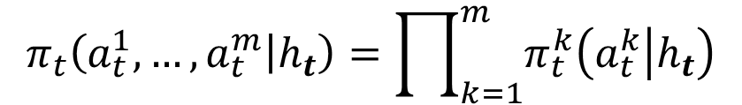
2 Methodology
Discrete time factored action MDP (FA-MDP)
Action in vector representation
State transition
Policy over action mapped from history
$$a=(a^{1},…,a^{m})$$
$$P\left(s′ | s,a\right)=Pr\left(s_{t+1}=s′ | s_{t}=s,a_{t}=s\right)$$
$$π_{t}\left(a_{t} | h_{t}\right)=Pr\left(a_{t} | h_{t}\right)$$
$$h_{t}=(s_{0},a_{0},…s_{t−1},a_{t−1},s_{t})$$
Fully factorized policy
$$π_{t}\left(a_{t}^{1},…,a_{t}^{m} | h_{t}\right)=\prod_{k=1}^{m}{π_{t}^{k}\left(a_{t}^{k} | h_{t}\right)}$$

Slide 11
2 Methodology
Discrete time factored action MDP (FA-MDP)
Action in vector representation
State transition
Policy over action mapped from history
$$a=(a^{1},…,a^{m})$$
$$P\left(s′ | s,a\right)=Pr\left(s_{t+1}=s′ | s_{t}=s,a_{t}=s\right)$$
$$π_{t}\left(a_{t} | h_{t}\right)=Pr\left(a_{t} | h_{t}\right)$$
$$h_{t}=(s_{0},a_{0},…s_{t−1},a_{t−1},s_{t})$$
Fully factorized policy
Remove this assumption and the problem can be regarded as a more flexible multi-agent case
$$π_{t}\left(a_{t}^{1},…,a_{t}^{m} | h_{t}\right)=\prod_{k=1}^{m}{π_{t}^{k}\left(a_{t}^{k} | h_{t}\right)}$$

Slide 12

2 Methodology
Discrete time factored action MDP (FA-MDP)
Action in vector representation
State transition
Policy over action mapped from history
$$a=(a^{1},…,a^{m})$$
$$P\left(s′ | s,a\right)=Pr\left(s_{t+1}=s′ | s_{t}=s,a_{t}=s\right)$$
Decided every $c^{m}$ time steps

Slide 13
2 Methodology
Discrete time factored action MDP (FA-MDP)
Action in vector representation
State transition
Policy over action mapped from history
$$a=(a^{1},…,a^{m})$$
$$P\left(s′ | s,a\right)=Pr\left(s_{t+1}=s′ | s_{t}=s,a_{t}=s\right)$$
Decided every $c^{m}$ time steps

Slide 14
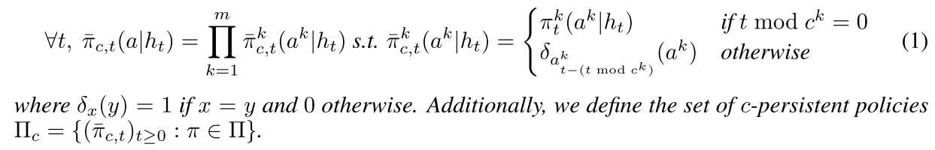

2 Methodology
Discrete time factored action MDP (FA-MDP)
Policy over action mapped from history
Decided every $c^{m}$ time steps
Impose each action to be kept persistent by introducing constraint on fixed time steps

Slide 15
2 Methodology
Discrete time factored action MDP (FA-MDP)
Policy over action mapped from history
Decided every $c^{m}$ time steps
Through this definition, action $a_{t}^{m}$ is decided every $c^{m}$ time step, but implement at every step
Notes:
In our problem, action is decided every unpredefined time step, and implement at a step

Slide 16
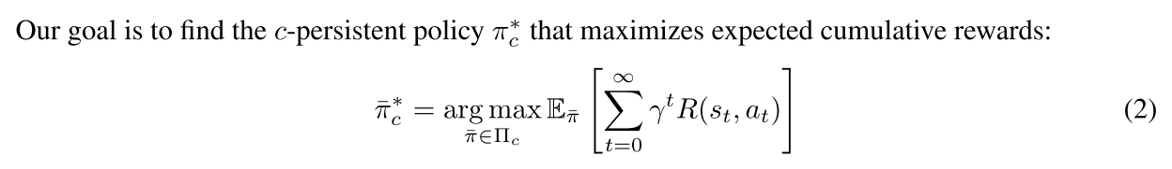
2 Methodology
Discrete time factored action MDP (FA-MDP)
Policy over action mapped from history
Notes:
In our problem, action is decided every unpredefined time step, and implement at a step

Slide 17
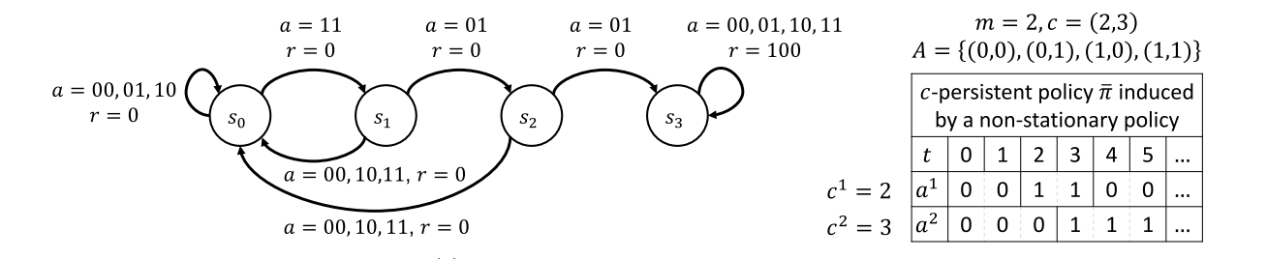
2 Methodology
Discrete time factored action MDP (FA-MDP)
Notes:
In our problem, action is decided every unpredefined time step, and implement at a step

Slide 18
2 Methodology
Discrete time factored action MDP (FA-MDP)
* We can not ignore the action persistence to find optimal policy in FA-MDP
Notes:
In our problem, action is decided every unpredefined time step, and implement at a step

Slide 19
2 Methodology
Discrete time factored action MDP (FA-MDP)
* We can not ignore the action persistence to find optimal policy in FA-MDP
If follow action persistence scheme $L≜LCM(c^{1},…,c^{m})$ time steps, then we have to explore policy in an action space ${\left|A\right|}^{L}$
Notes:
In our problem, action is decided every unpredefined time step, and implement at a step

Slide 20
2 Methodology
Discrete time factored action MDP (FA-MDP)
* We can not ignore the action persistence to find optimal policy in FA-MDP
* If we consider time step for each action, then there will be exponential time complexity
Notes:
In our problem, action is decided every unpredefined time step, and implement at a step

Slide 21
2 Methodology
Policy evaluation for c-persistent policy
Policy improvement for c-persistent policy
Notes:
In our problem, action is decided every unpredefined time step, and implement at a step

Slide 22

2 Methodology
Policy evaluation for c-persistent policy
“Action projection” : agent choose decision every time step, then use this function to retain the actual changed action with respect to the c-persistence scheme
Notes:
In our problem, action is decided every unpredefined time step, and implement at a step

Slide 23

2 Methodology
Policy evaluation for c-persistent policy
“Action projection” : agent choose decision every time step, then use this function to retain the actual changed action with respect to the c-persistence scheme
“One-step Bellman operator” : Map value function to value function based on next-step value function with respect to current c-persistent policy
Notes:
In our problem, action is decided every unpredefined time step, and implement at a step

Slide 24
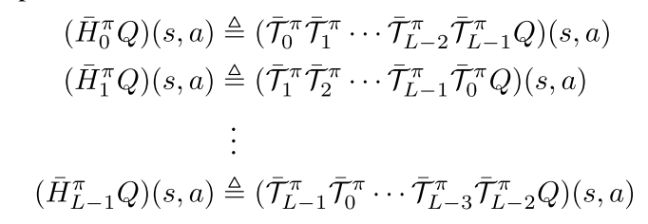
2 Methodology
Policy evaluation for c-persistent policy
“Action projection” : agent choose decision every time step, then use this function to retain the actual changed action with respect to the c-persistence scheme
“One-step Bellman operator” : Map value function to value function based on next-step value function with respect to current c-persistent policy
“L-step Bellman operator” : Bellman operator for c-persistent policy in L step horizon(manner)
Notes:
In our problem, action is decided every unpredefined time step, and implement at a step

Slide 25
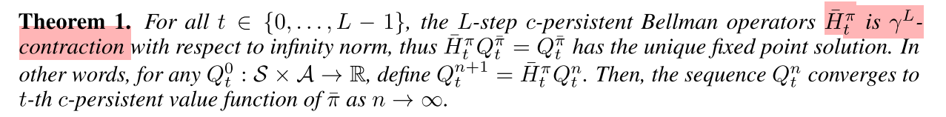
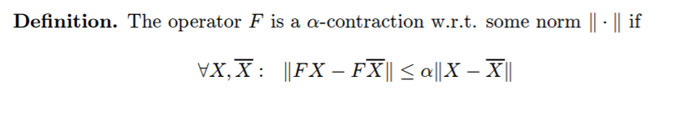
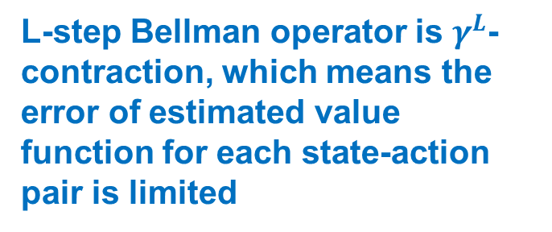
2 Methodology
Policy evaluation for c-persistent policy
L-step Bellman operator is $γ^{L}$-contraction, which means the error of estimated value function for each state-action pair is limited
Notes:
In our problem, action is decided every unpredefined time step, and implement at a step

Slide 26
2 Methodology
Policy evaluation for c-persistent policy
“One-step Bellman operator” : Map value function to value function based on next-step value function with respect to current c-persistent policy
Notes:
In our problem, action is decided every unpredefined time step, and implement at a step

Slide 27
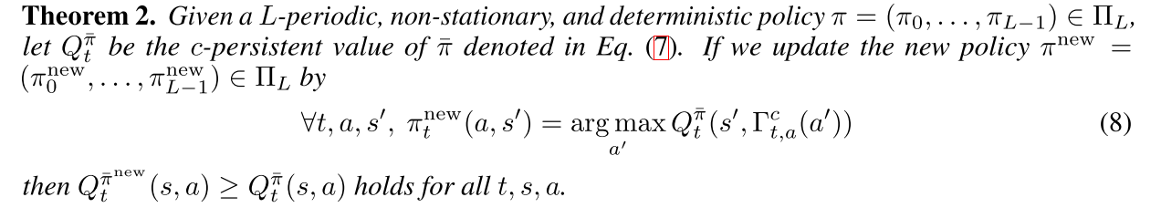
2 Methodology
Policy improvement for c-persistent policy
Update policy based on the greedy policy
Notes:
In our problem, action is decided every unpredefined time step, and implement at a step

Slide 28
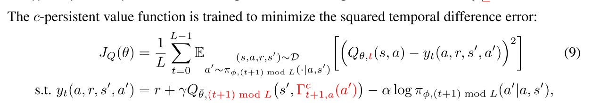
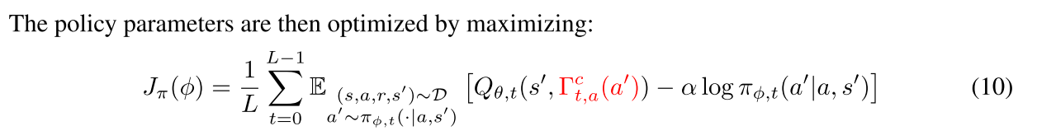
2 Methodology
Action-persistent actor-critic
Critic
Actor
Notes:
In our problem, action is decided every unpredefined time step, and implement at a step

Slide 29
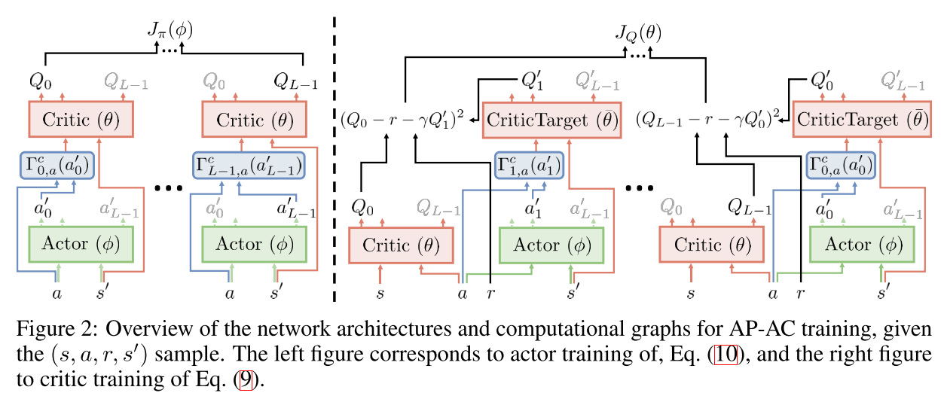
2 Methodology
Action-persistent actor-critic
Notes:
In our problem, action is decided every unpredefined time step, and implement at a step

Slide 30
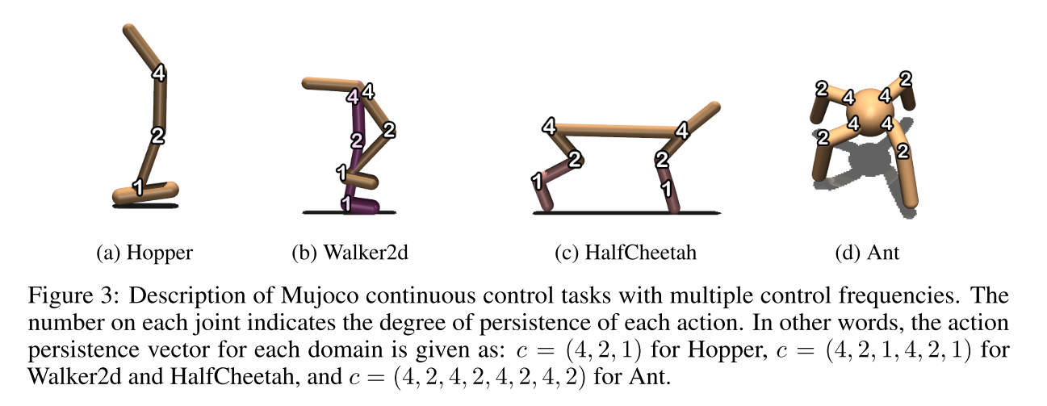
3 Experiments

Slide 31
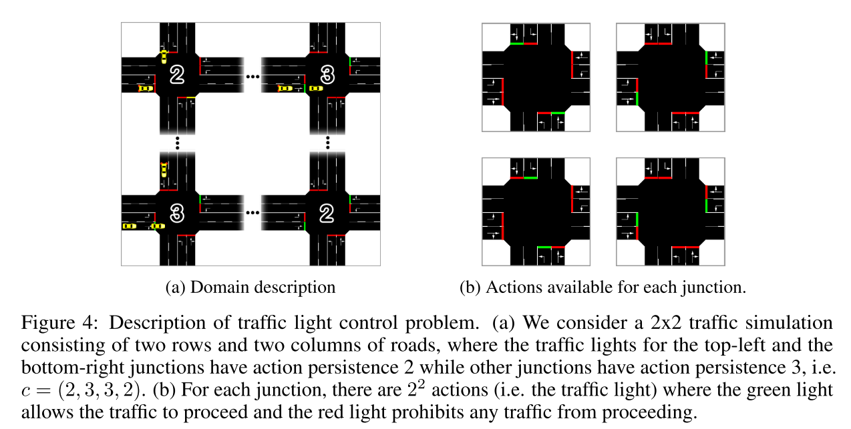
3 Experiments

Slide 32
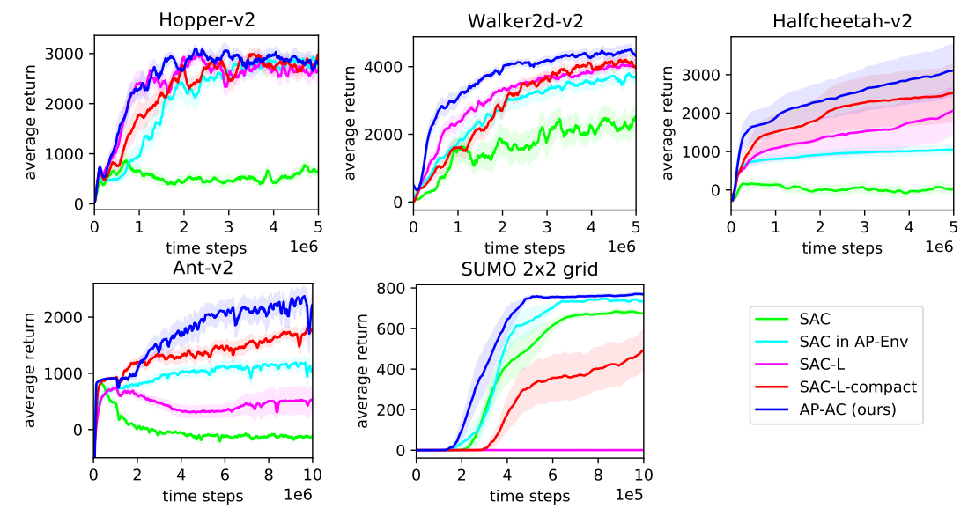
3 Experiments
SAC: train in no- action persistence environment
SAC in AP-Env: train in action persistence environment
SAC-L: train in action persistence environment. Observation consists of time step and last L action
SAC-L-Compact: train in action persistence environment. Observation consists of time step and last action

Slide 33
Thank you !

